Slide 1



BASICS OF PHP

Slide 2
INTRODUCTION TO PHP
What is PHP?
  PHP stands for "Hypertext Preprocessor."
  It's a server-side scripting language used primarily for web development.
  Open-source and widely used for dynamic content, database interaction, and more.

Slide 3
PHP SYNTAX
PHP Script Structure
  PHP code is embedded within HTML using <?php ?> tags.
<?php
echo "Hello, World!";
?>

Slide 4
PHP DATA TYPES
  String: Text, e.g., "Hello"
  Integer: Whole numbers, e.g., 5
  Float (Double): Decimal numbers, e.g., 3.14
  Boolean: true or false
  Array: Collection of values, e.g., [1, 2, 3]
  Object: Instances of classes
  NULL: Variable with no value

Slide 5
PHP VARIABLES
  $ symbol followed by the name: $variableName
  Variables are case-sensitive
$name = "John";
$age = 25;

Slide 6
PHP OPERATORS
  Arithmetic Operators: +, -, *, /, %, **
  Assignment Operators: =, +=, -=, *=, /=
  Comparison Operators: ==,===, !=, !==, >, <, >=, <=, <=>
  Logical Operators: &&, ||, !

Slide 7
WORKING WITH ARRAYS
  An array is a data structure that can store multiple values in a single variable.
  Types of Arrays in PHP:
  Indexed Arrays: Arrays with numeric indices.
$colors = ["Red", "Green", "Blue"];
  Associative Arrays: Arrays with named keys.
$ages = ["John" => 25, "Jane" => 30];
  Multidimensional Arrays: Arrays containing one or more arrays.
  $students = [ ["name" => "John", "age" => 25],
  ["name" => "Jane", "age" => 30] ];

Slide 8

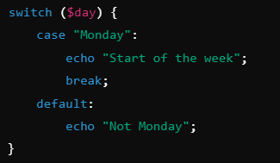
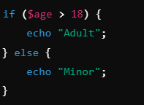
CONDITIONALS IN PHP
  If Statements
  If-Else Statements
  Switch Statements

Slide 9
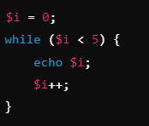
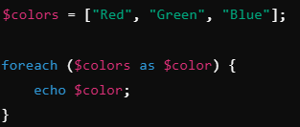

LOOPS IN PHP
  While Loop
  For Loop
  Foreach Loop

Slide 10
FORM HANDLING IN PHP
  GET vs POST Methods
  GET: Sends data via URL, less secure.
  POST: Sends data in the HTTP request body, more secure.

Slide 11

THANK YOU

